Slide 1


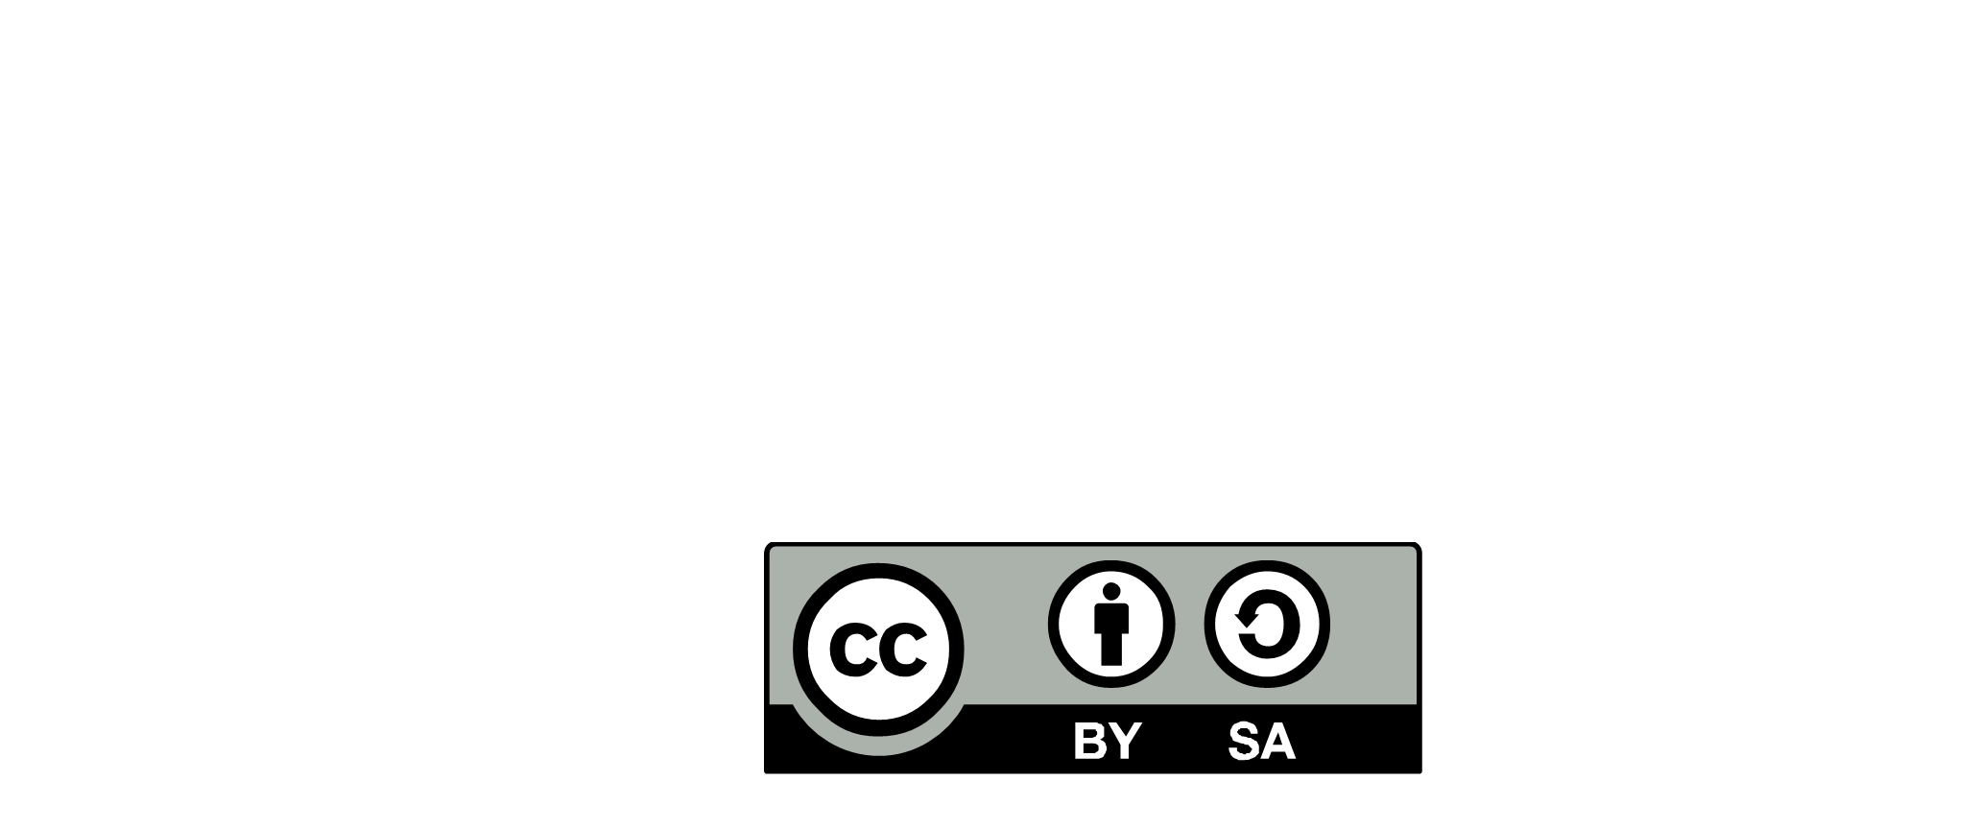
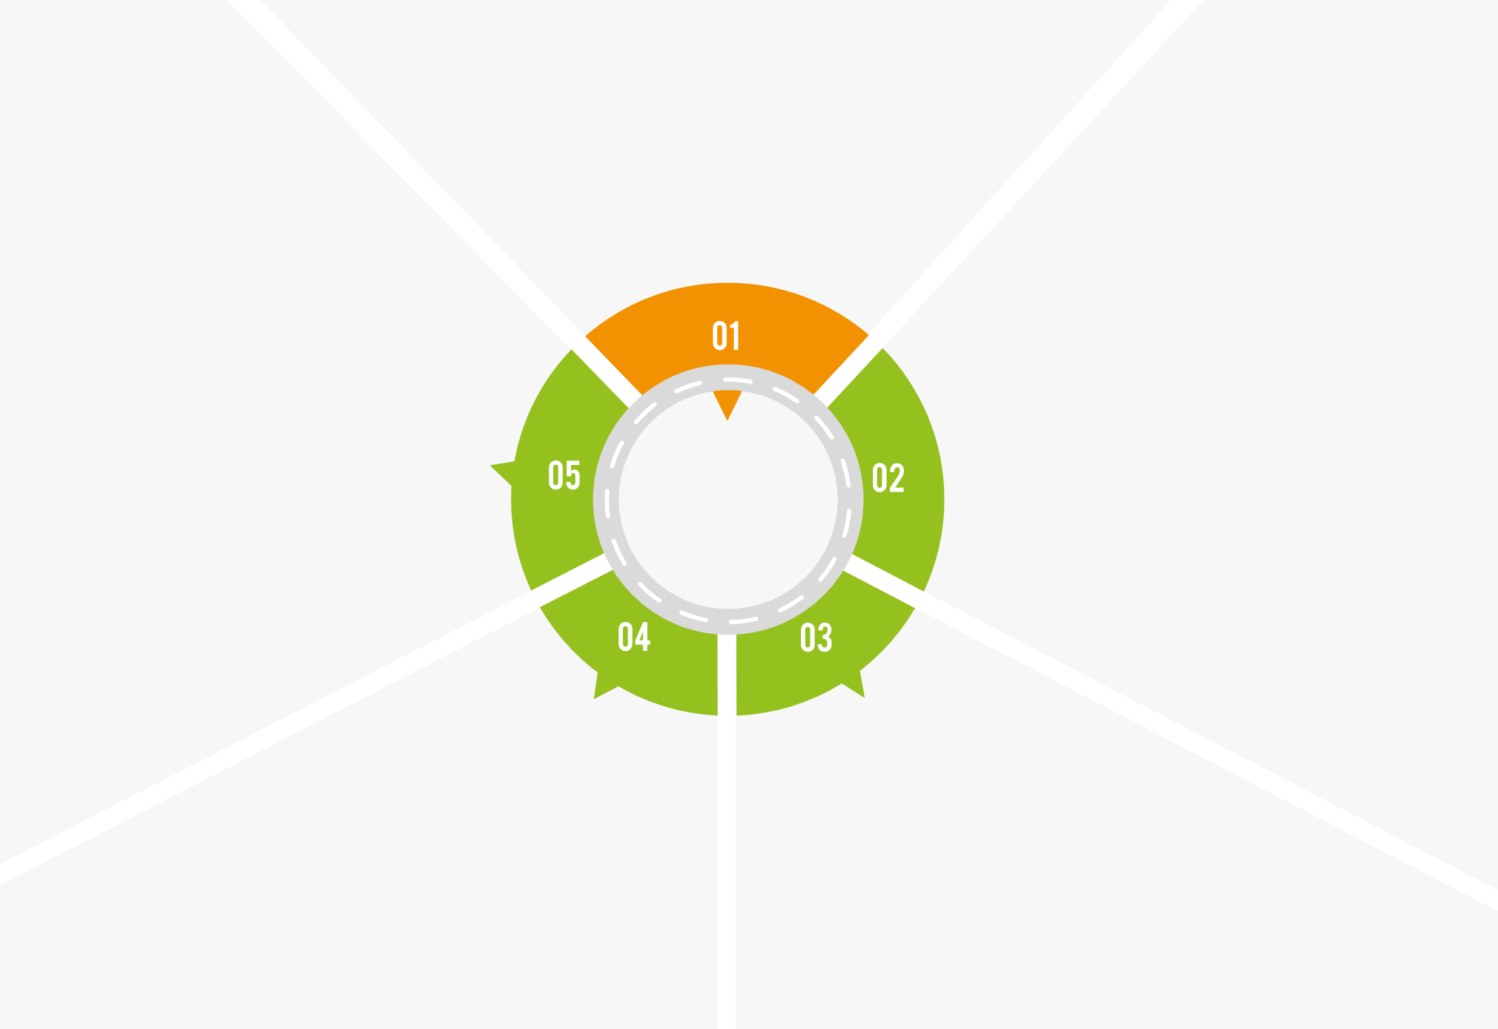
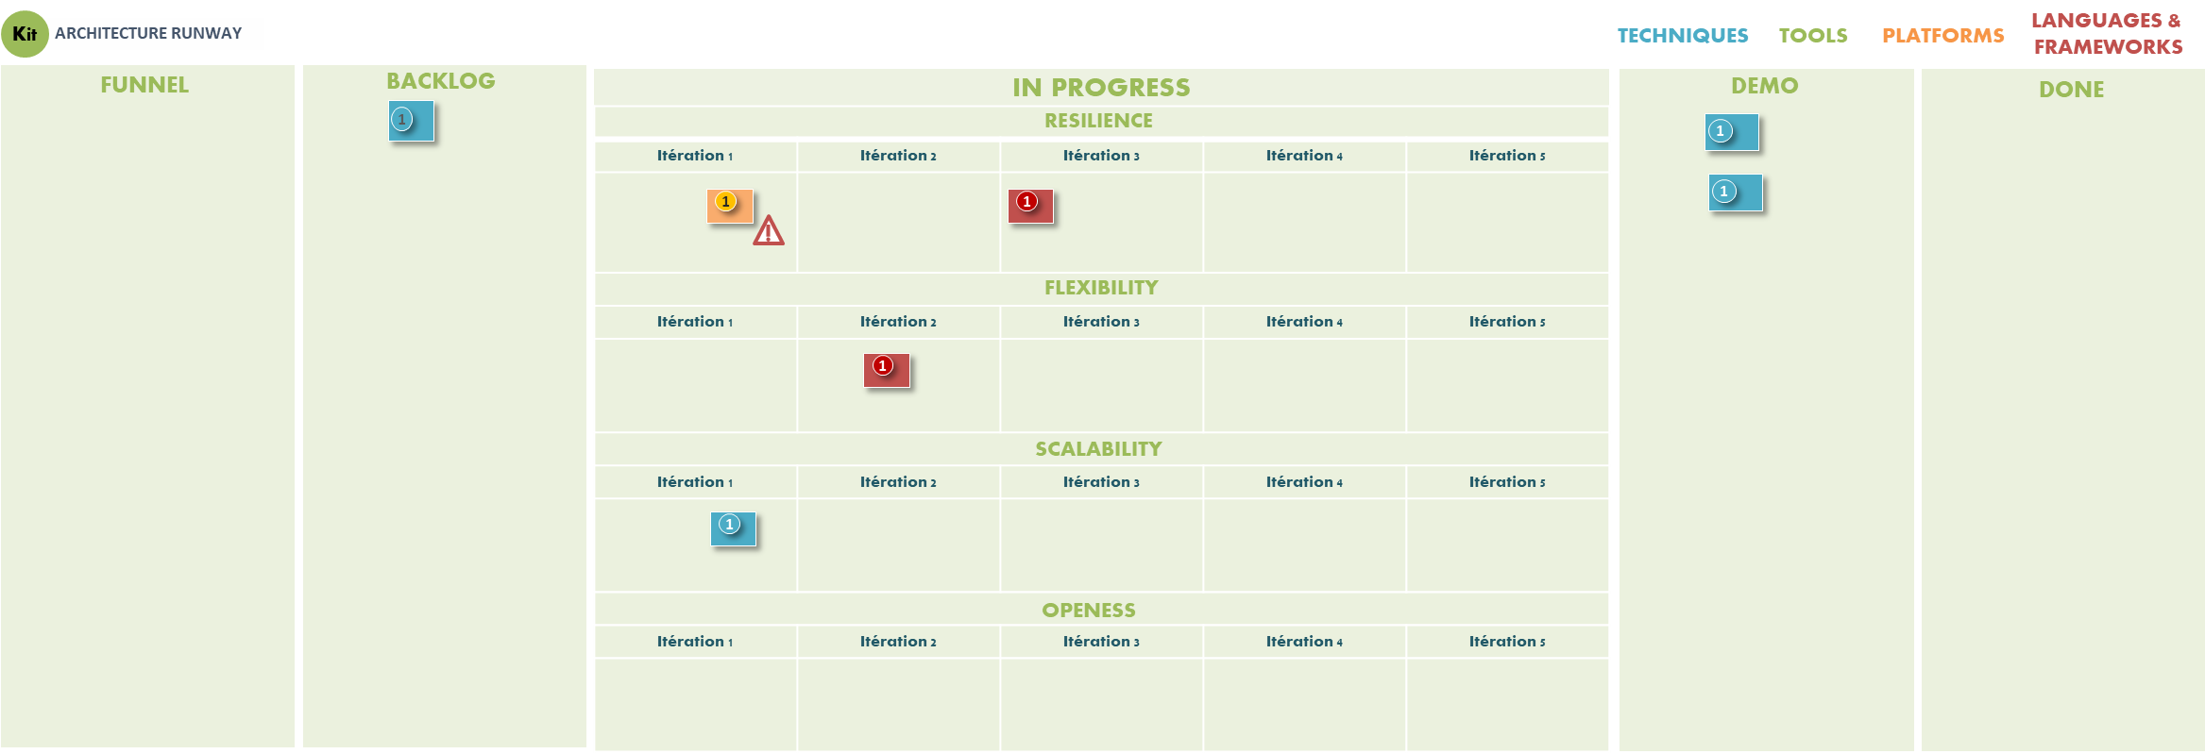


ARCHITECTURE DECISION RECORD
EVERY DECISION
WEEKLY
ARCHITECTURE
01 – NEW REQUIREMENT OR CHANGE
Architecture for Agile projects has to be described and defined differently. Not all decisions will be made at once, nor will all of them be done when the project begins. — Michael Nygard
CONSOLIDATED PRODUCT BACKLOG
FEATURES
Foster a documentation habit
Make a decision, then document it
ENABLERS
ADR
DECISION LOG
ADR
Use the standard Gitlab template
DECISION LOG
Title — Title of the decision record
Decision — The decision that was made
Status — Status can be proposed, accepted or superseded. If you make any decisions and you need to change them later, you can simply add a new record with the changed status
Context — What is the context of this decision? It is important to capture the full context of the decision so that the reader knows the reasons behind it
Considered Options — optional, other proposed options and main reason for its dismissal
Consequences — What becomes easier or more difficult to do because of this change?
05 – SHARED FEEDBACKS AND MERGED AUTHOR
02 – EXPLORE SOLUTIONS
Store with the code. Use plain text
Integrates with peer review workflow and tools, Git Friendly and submitted through pull requests, remain in sync with the code
TEAM
LEADER
DEV.
DELIVERY
SQUAD(s)
TECH
LEAD
ADR
ADR
DECISION LOG
DECISION LOG
Delegate ADR creation to team members
Small responsibility, little risk
Easy to review
Peer review as you would with code
Get the whole team involved
04 – DRAFT ADR AND SUBMIT PULL REQUEST
03 – BUILD CONSENSUS

